Slide 1
Proiect finanțat de Comisia Europeană prin programul Erasmus+
2021-1-RO01-KA121-VET-000011688

Slide 2
Jobshadowing
25.05.2022 – 30.05.2022
Marian Radu-Mic
Liceul Tehnologic de Transporturi Auto – Craiova
Microbit Servicio Técnico - Malaga

Slide 3
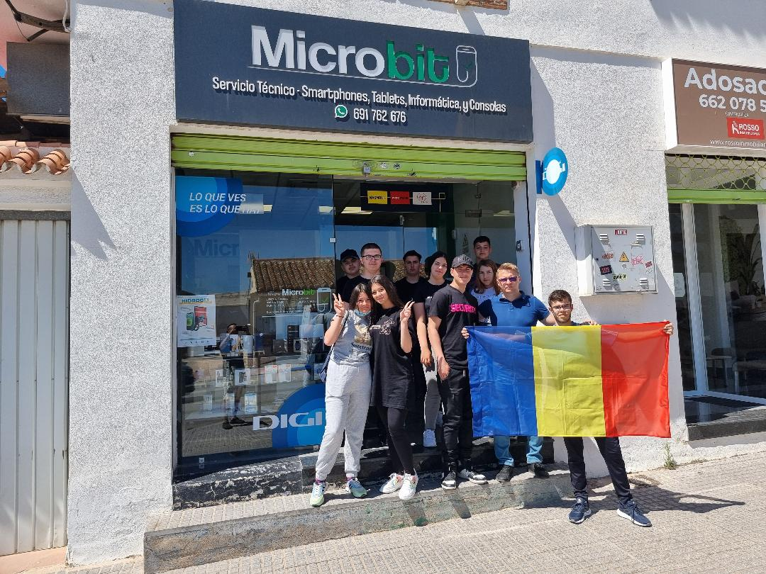
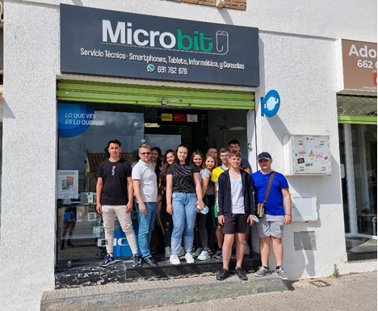
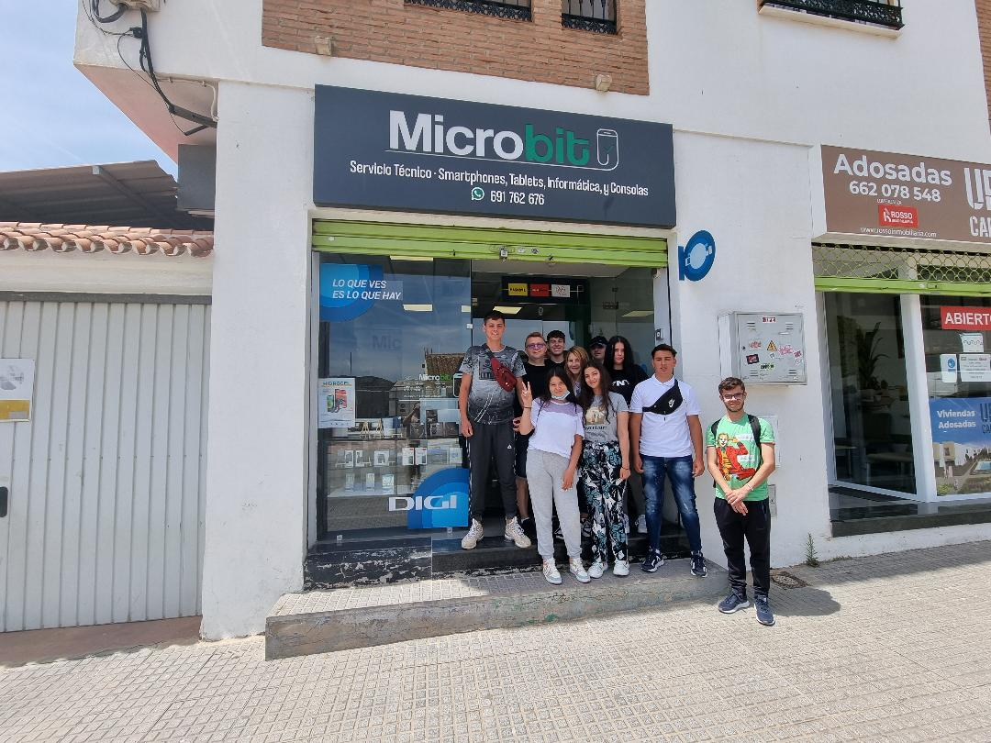

Slide 4
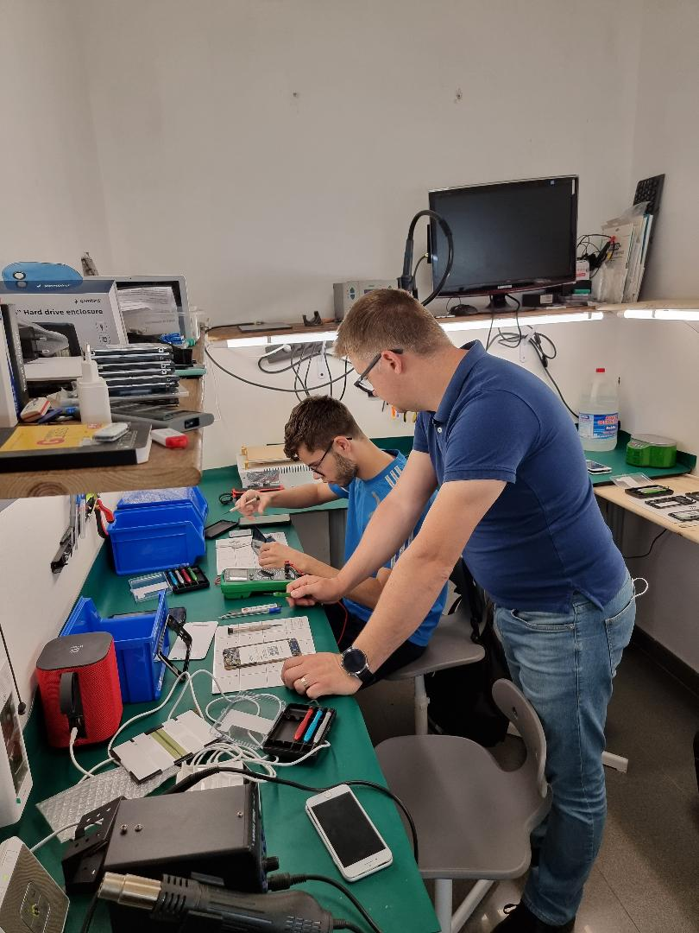
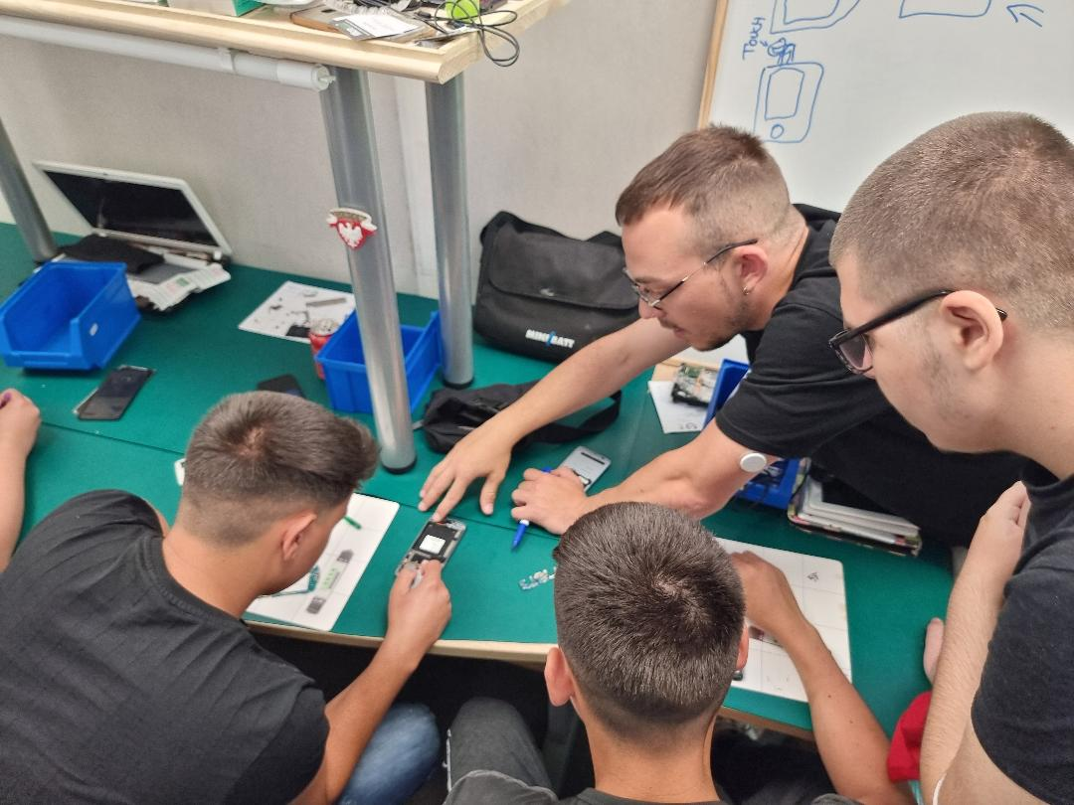
Understanding the particularities of the practical training activities carried out at the economic agent

Slide 5
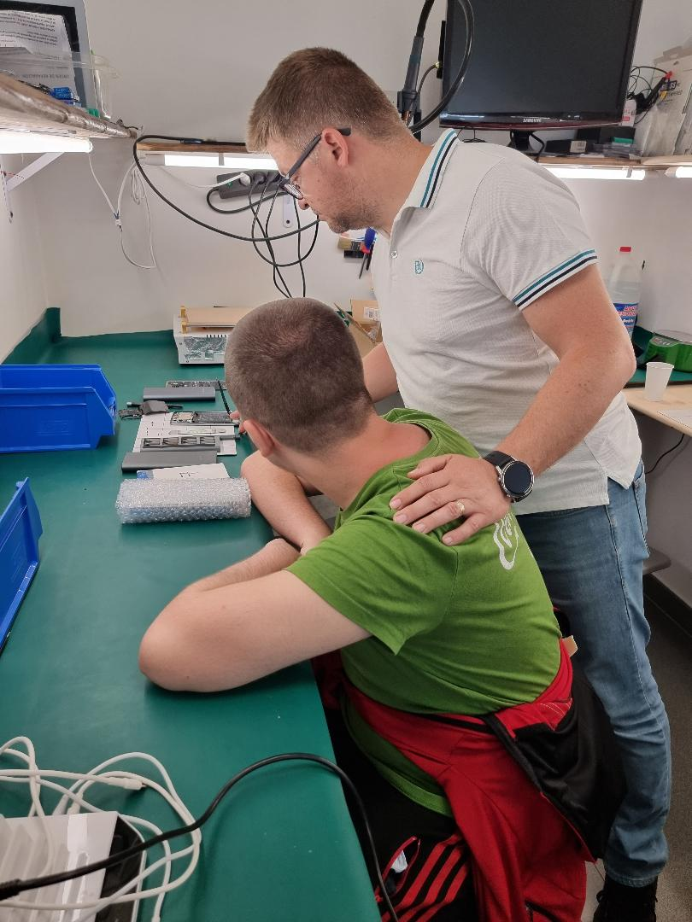
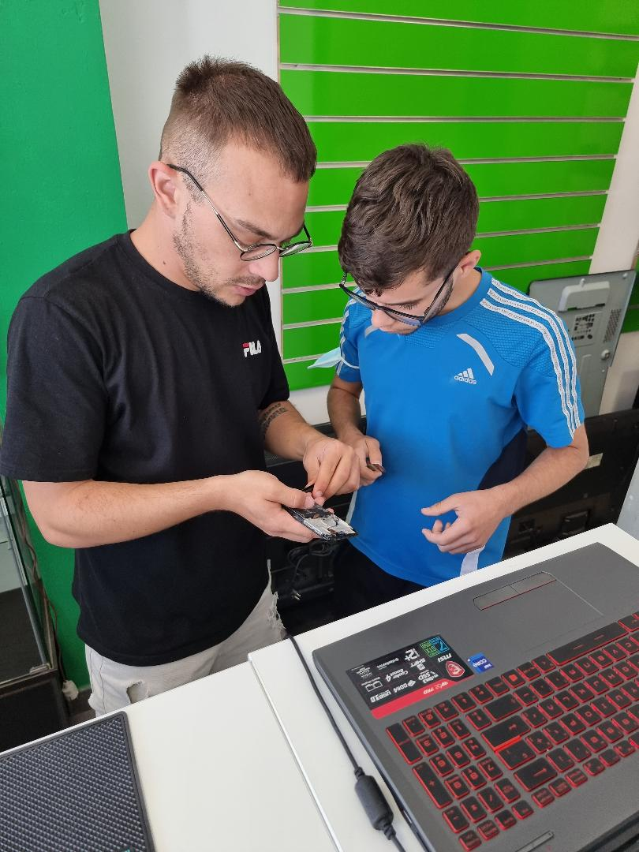
Training methods specific to practical training activities

Slide 6
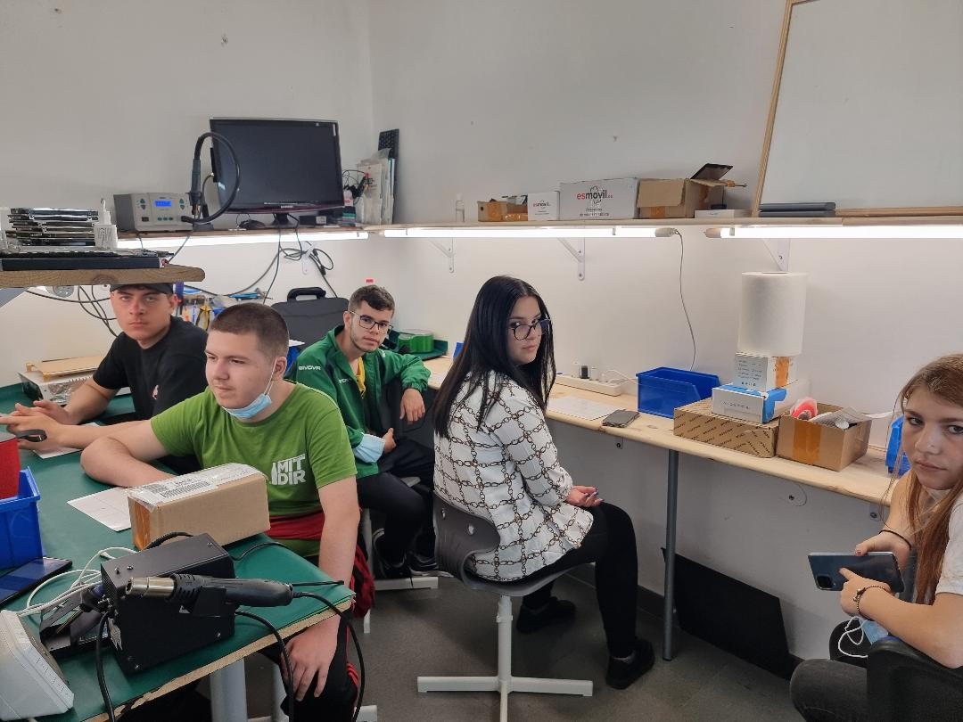
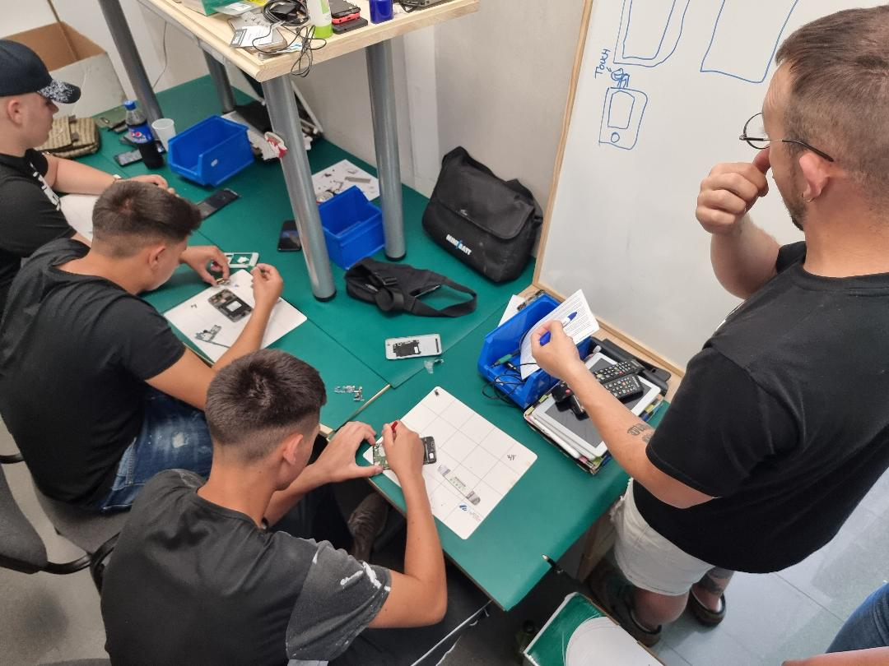
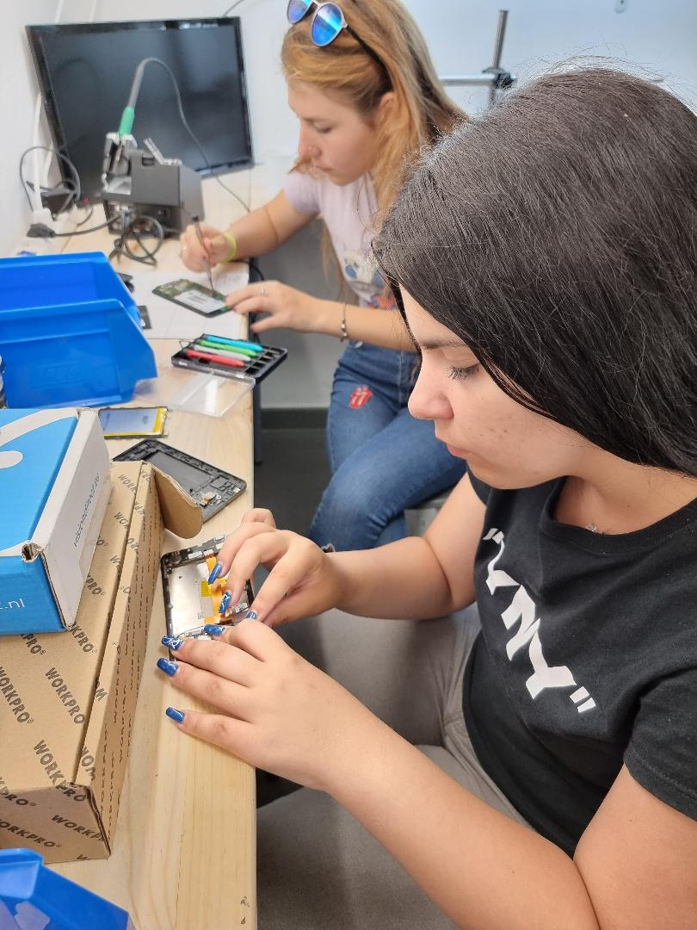
Development of the soft skills

Slide 7
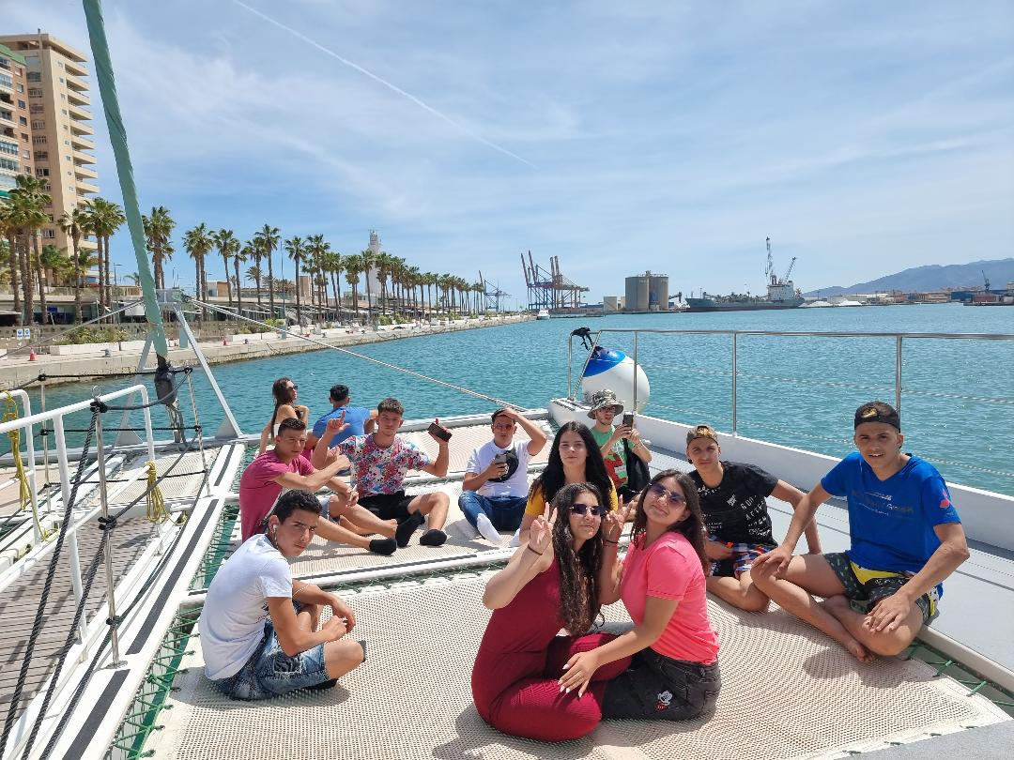
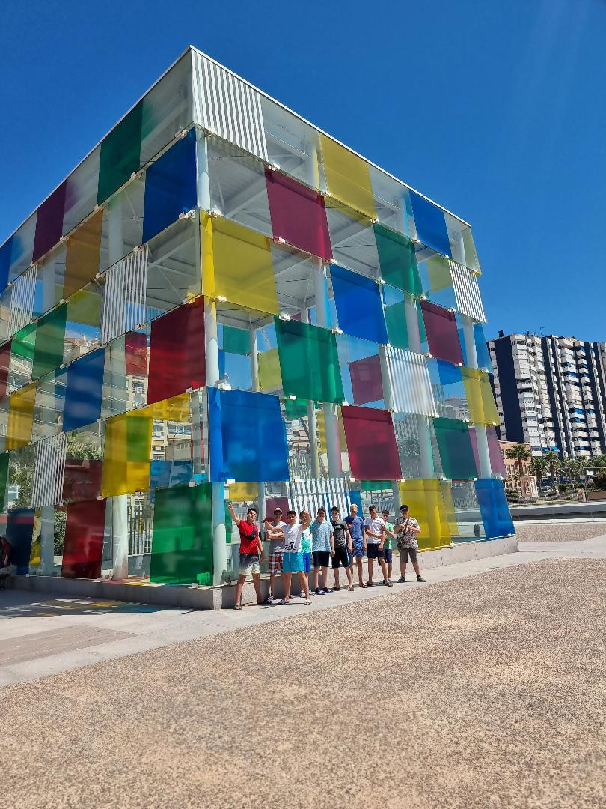
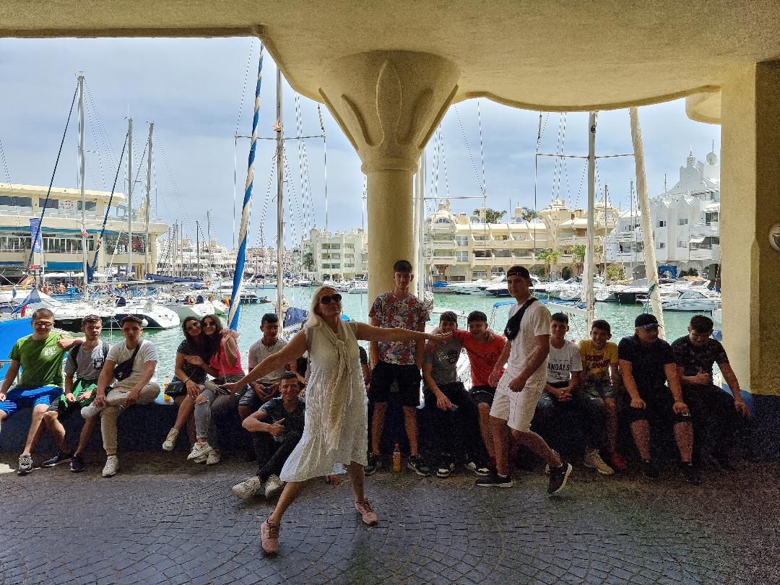
Interculturality and a little fun

Slide 8
This material reflects only the author's point of view and the European Commission is not responsible for any use that may be made of the information it contains.

